Slide 1

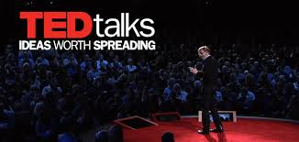
TED Talk Recommendation system and Summarization
Roja Rani Jyothi
Data Science Intensive Capstone Project
Springboard - 2020

Slide 2
Context
TED, which operates under the slogan 'Ideas worth spreading' is a non profit devoted to spreading ideas, usually in the form of short, powerful talks (18 minutes or less).
Our main goal here in this project is to find out the similarity between TED Talks and based on those similarities to build a recommendation system. And second one is TED Talk summarization.

Slide 3
problem
Similarity between TED Talks?
Based on the similarity, building a recommendation system to decide which talk they might watch?
Summarization of TED Talks?

Slide 4
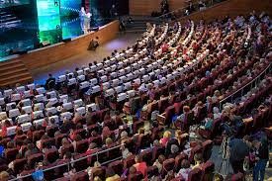
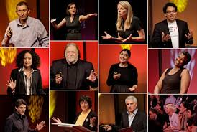
Who might care?
1. Audience who wants to know the summary of the talk.
2. Audience who are looking for the content relevant recommendations.
3. A TED talk presenter can use it to know the common topic in which people are more interested to listen and thus he can plan the topic of his talk accordingly.

Slide 5
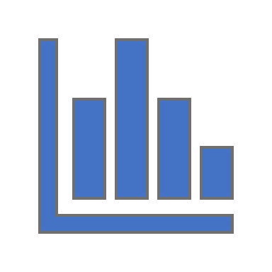
Data Information
Data Acquired from Kaggle.com
ted_main.csv - Contains data on actual TED Talk metadata and TED Talk speakers.
transcripts.csv - Contains transcript and URL information for TED Talks

Slide 6
Data Wrangling
Data Cleaning:
Checked the NULL values.
Checked the duplicate values
Type casting the columns – Converted date columns from Unix format to datetime

Slide 7
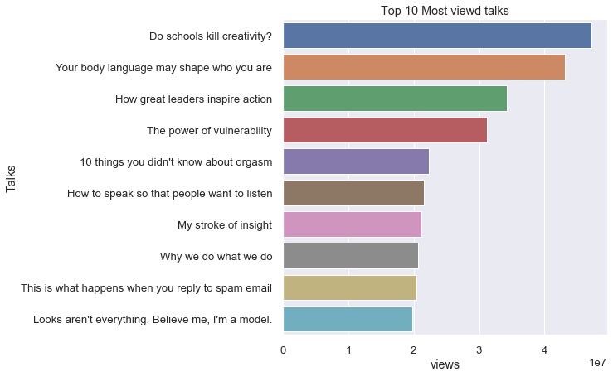
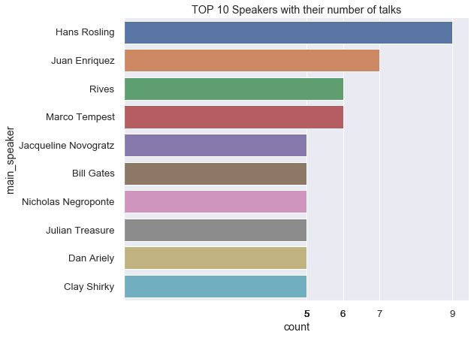
Exploratory Data analysis
Most viewed talks of all time
Top 10 speakers

Slide 8
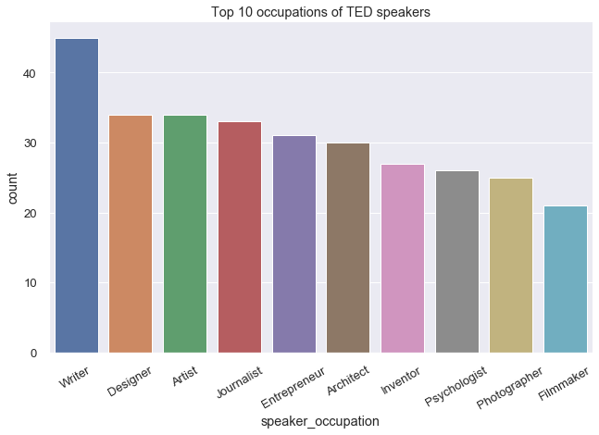
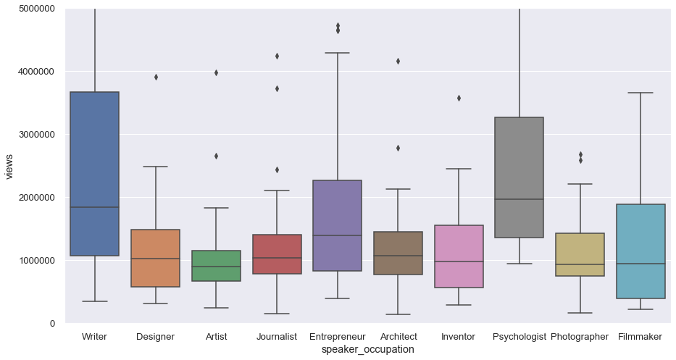
Top 10 occupations of TED SPEAKERS
Number of views with respect to occupation

Slide 9
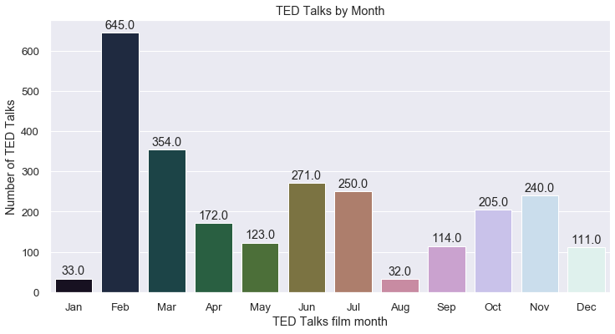
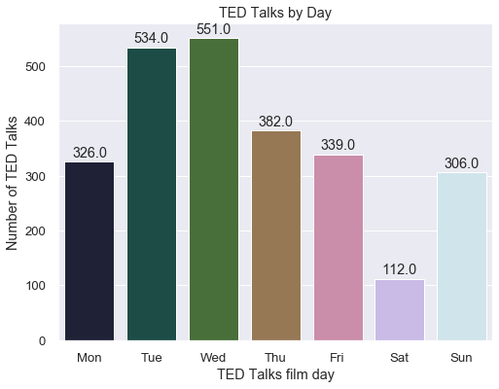
TED TALKS BY MONTH
TED TALKS BY DAY

Slide 10
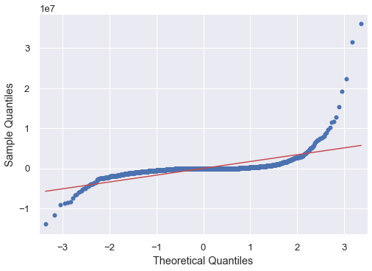
HYPOTHESIS TESTING: IS THERE ANY RELATIONSHIP BETWEEN VIEWS AND COMMENTS
Aftre performing One-Way ANOVA Test using OLS Model, WE GOT P-VALUE AS 0.9965.
RESULT: From the results, we concluded that There is no statistically significant relationship between views and speakers occupation

Slide 11
Text Pre processing using spaCy
Converting
all letters to lower or upper case
Converting
numbers into words or removing numbers
Removing
punctuations, accent marks and other diacritics
Removing
white spaces
Expanding
abbreviations
Removing
stop words, sparse terms, and particular words

Slide 12
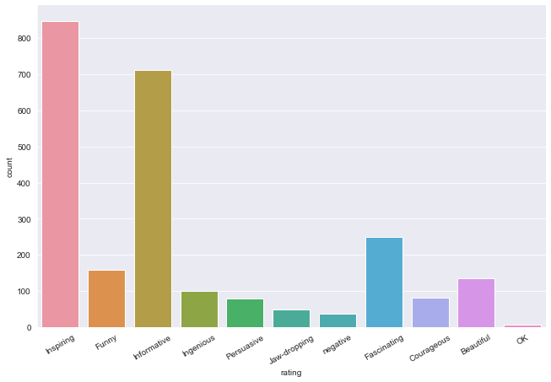
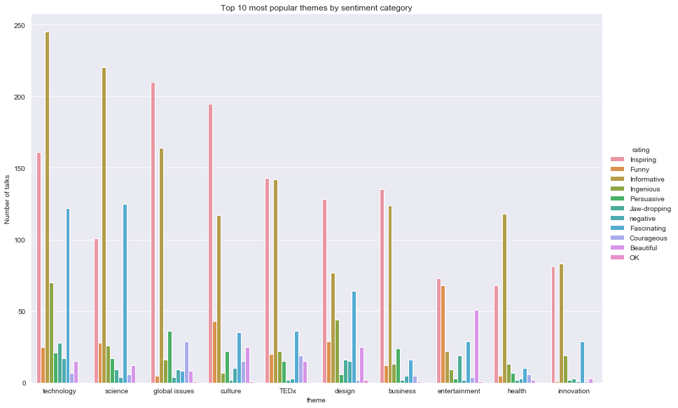
FEATURE EXTRACTION DERIVED RATINGS CATEGORY FOR EACH TRANSCRIPT FROM RATINGS FEATURE

Slide 13
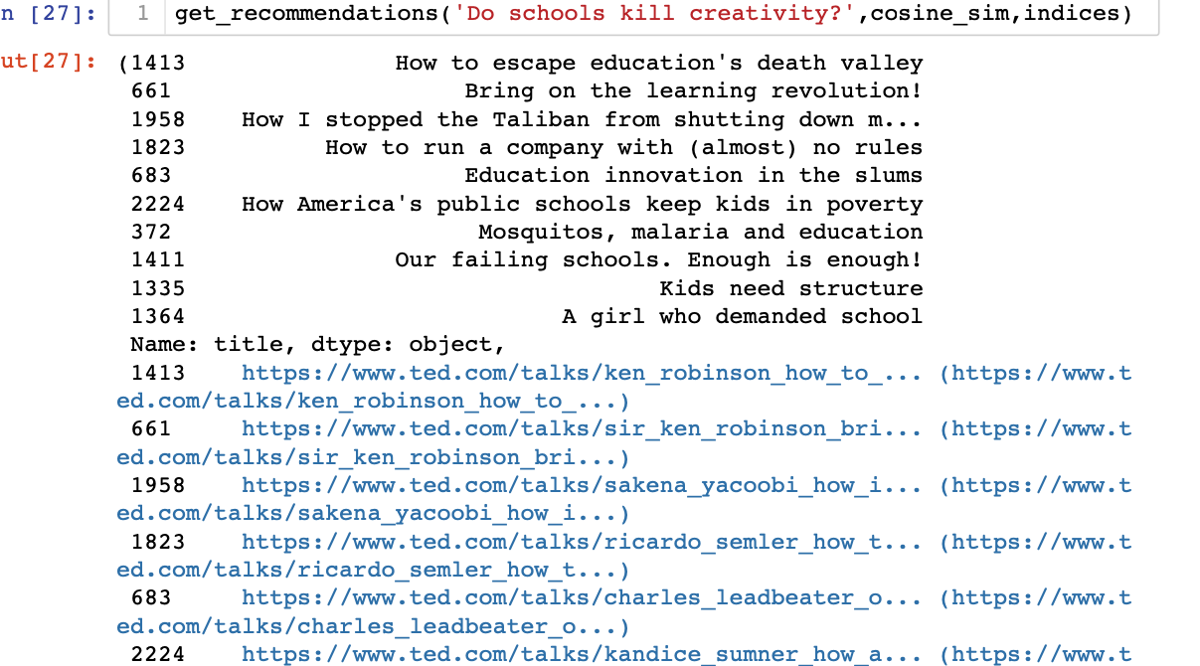
Recommendation function
STEPS
1.Take a movie title, cosine similarity matrix, and indices series as arguments.
2.Extract pairwise cosine similarity scores for the movie
3.Sort the scores in descending order
4.Output titles corresponding to the highest scores

Slide 14
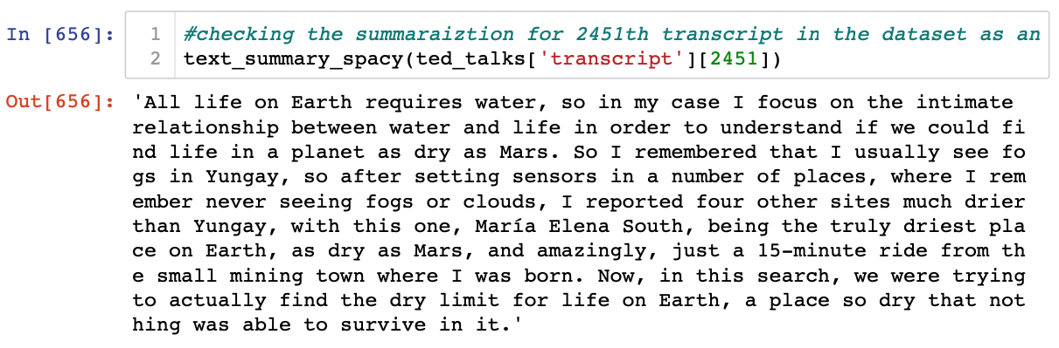
TED TALK SUMMARIZATION
tried below methods:
Text summarization using spaCy
Text Summarization using Gensim with TextRank¶
Text Summarization with Sumy
We found that summarization with spaCy gave good results compared to others for this dataset.

Slide 15
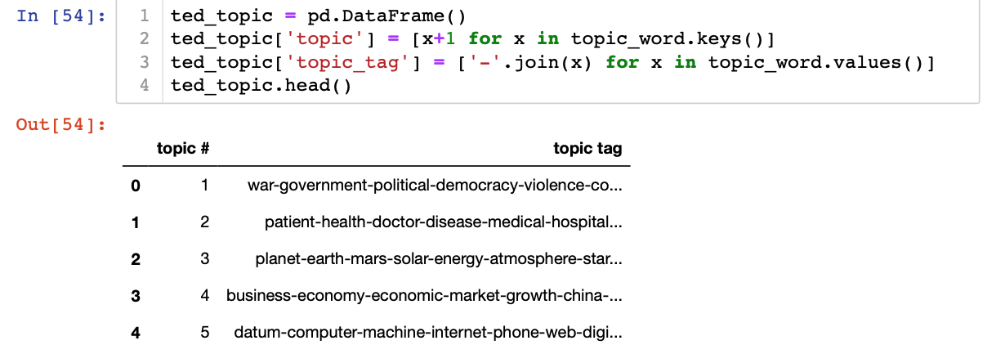
Topic modeling
we tried two algorithms
LDA (Latent Dirichlet Allocation)
NMF (Non-negative Matrix Factorization) for topic modelling
LDA for this TED Talks dataset produces noisy data and are hard to interpret.
NMF was able to find more meaningful topics.
So used the NMF model for final topic modeling and got the top 20 topics along with tags.

Slide 16
Conclusion
Using this available data
We calculated cosine similarity
Based on similarity we buit a recommendation system
We did talk summarization using spacy
In addition, we did topic modeling

Slide 17
Future improvements
The recommendation engines used by the official ted page, will be a degree of magnitude more sophisticated than what we demonstrated here and would also involve use of some sort of historical user-item interaction data. Would love to try the TED Talk recommendation system using historical user-item interaction data if available.
We can also make some more analysis over topic and area of TED Talk, by combining some other datasets like news article, social media post etc. to find for any pattern between how the hot discussed topics over world found from news article and social media post are included in TED talk topics, around the same time frame as of the hot discussion over the world.
THANK YOU!

